Slide 1
Moving towards net zero and farming systems fit for the future Dr Nicola D Cannon (Nicky) Professor of Agriculture Specialism in agronomy
Notes:
Established in 1845, with 25 Students.
The first agricultural college in the English speaking world
Granted Royal Charter
Today
Around 1,100 students
Four academic schools
Eight partner colleges
17,000 alumni
Our students join us from around the globe – we currently have students from 41 different countries studying with us.
We are fortunate to be located in a beautiful campus in the Cotwolds in the heart of the British countryside.
The cities of Bath, Bristol and Oxford are all within an hour’s drive of the University and London is less than 90 minutes away by train.

Slide 2
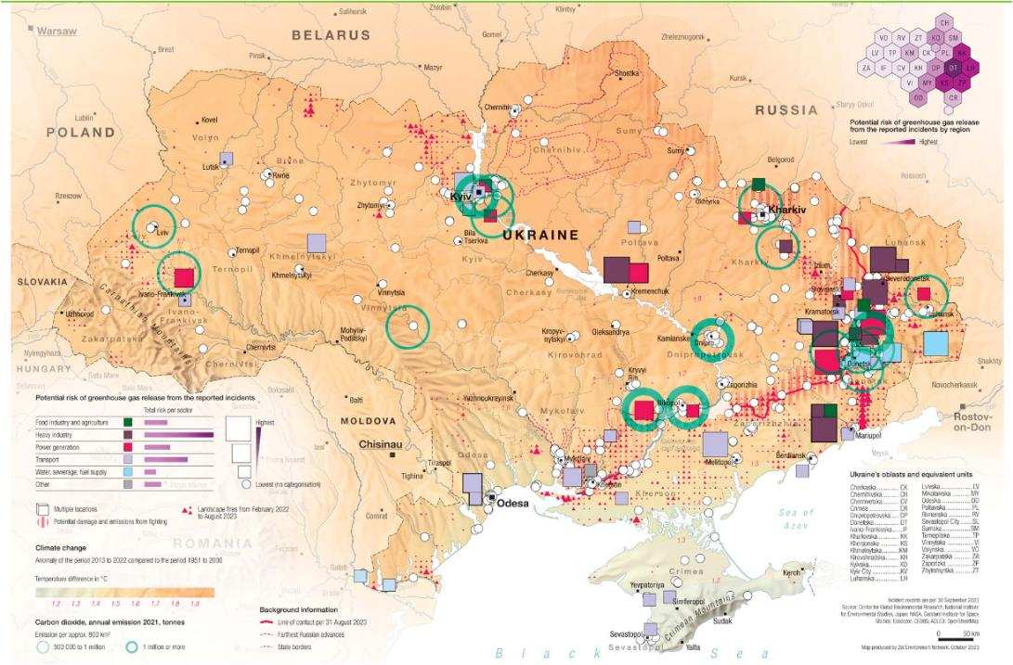
https://ceobs.org/ukraine-conflict-environmental-briefing-the-climate-crisis/

Slide 3
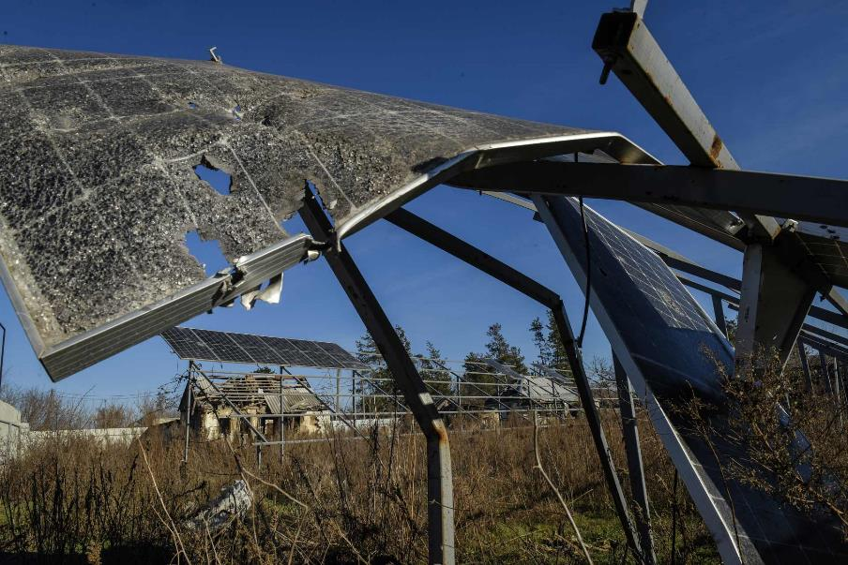
https://ceobs.org/ukraine-conflict-environmental-briefing-the-climate-crisis/

Slide 4
Ukraine climate policy before 2022
Ukraine’s economy was carbon intensive prior to 2022 esp energy, industry & ag
Economic downturn ‘helped’ Ukraine reach target emission reductions from 942.8 MT CO2 in 1990 to 327.3 in 2021
In 2016, Ukraine ratified the Paris Agreement to reduce emissions by 40% from the 1990 levels (this allowed for economic growth)
In 2021 submitted 2030 climate targets for UNFCCC aiming to slightly reduce emissions but allow economic growth
In mid 2020 Ukraine announced it would align itself to the European Green New Deal
https://ceobs.org/ukraine-conflict-environmental-briefing-the-climate-crisis/

Slide 5
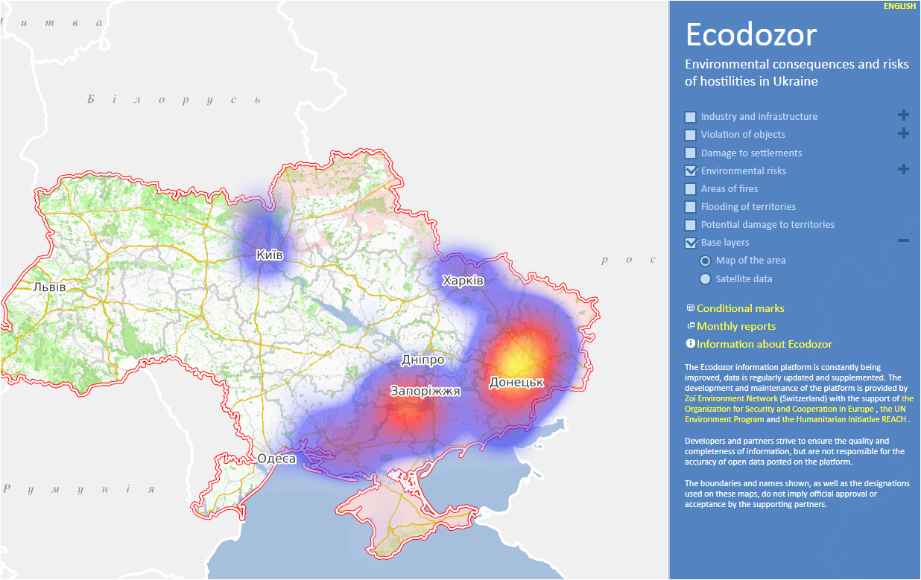
https://ecodozor.org/

Slide 6
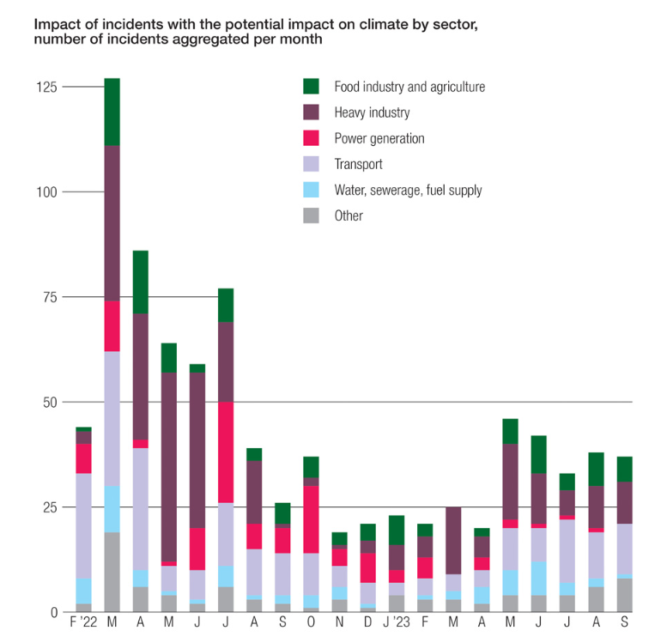
https://ecodozor.org/

Slide 7
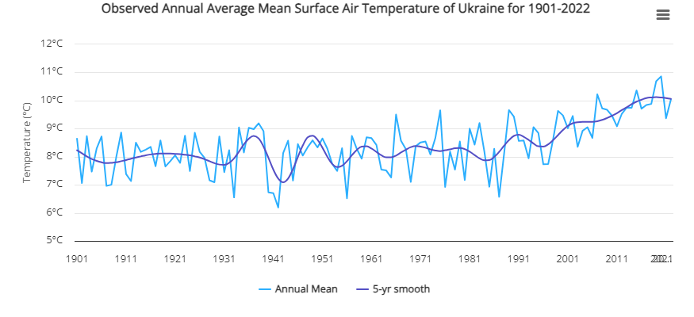
Ukraine is warming….
https://climateknowledgeportal.worldbank.org/country/ukraine/climate-data-historical

Slide 8
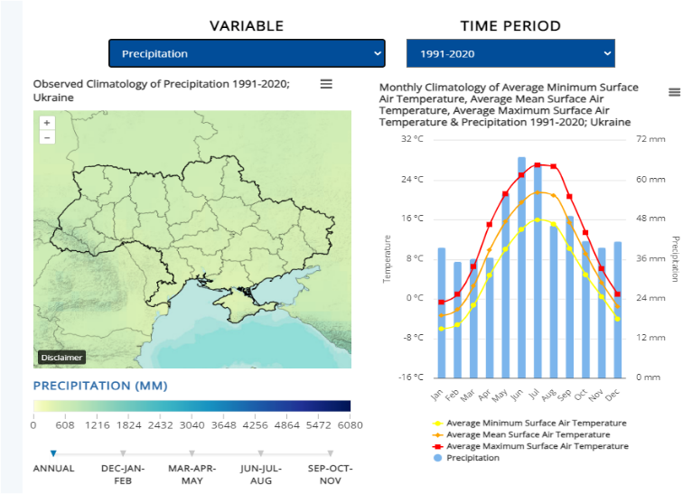
The country needs to be prepared for a changing climate
https://climateknowledgeportal.worldbank.org/country/ukraine/climate-data-historical

Slide 9
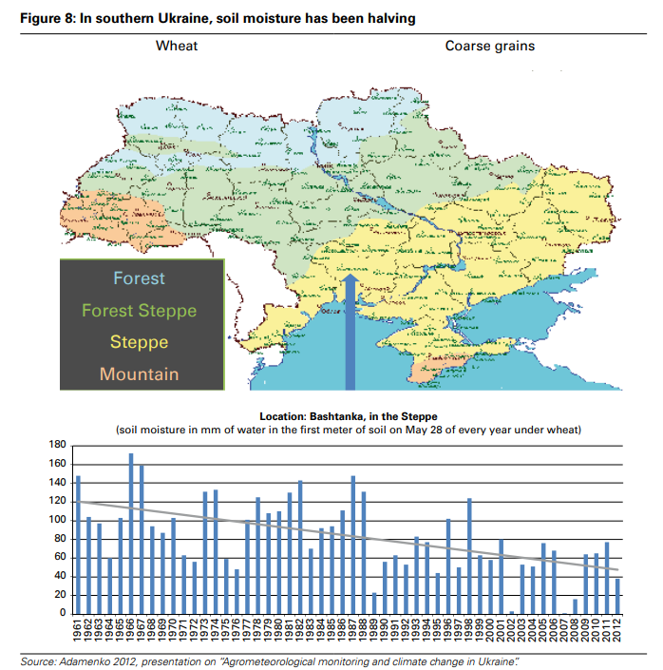
World Bank 2014

Slide 10
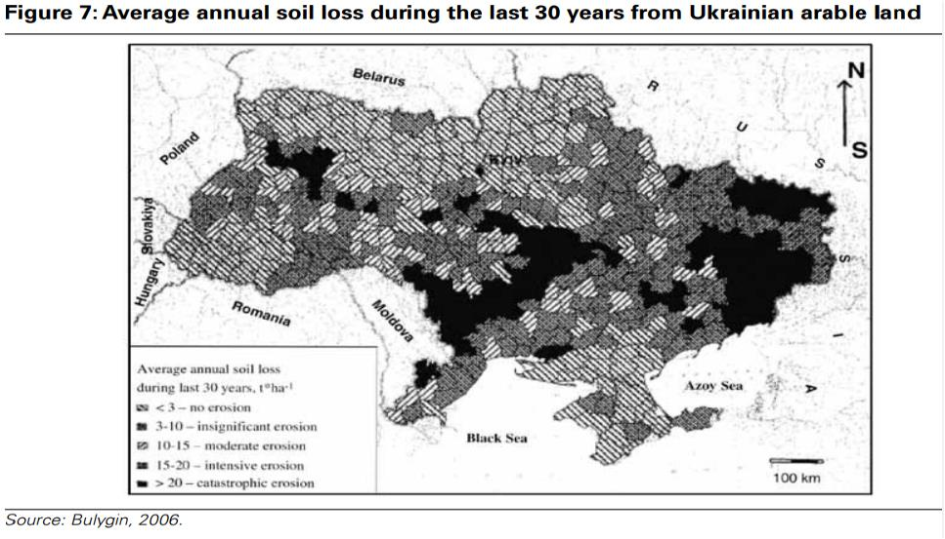
World Bank 2014

Slide 11
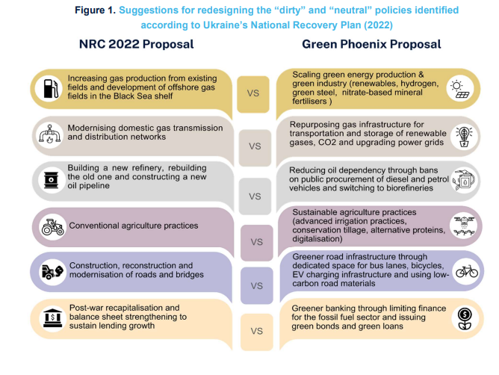
A new vision for Ukraine
https://www.smithschool.ox.ac.uk/sites/default/files/2023-06/The-Green-Phoenix-Framework-a-climate-positive-plan-for-economic-recovery-in-Ukraine.pdf

Slide 12
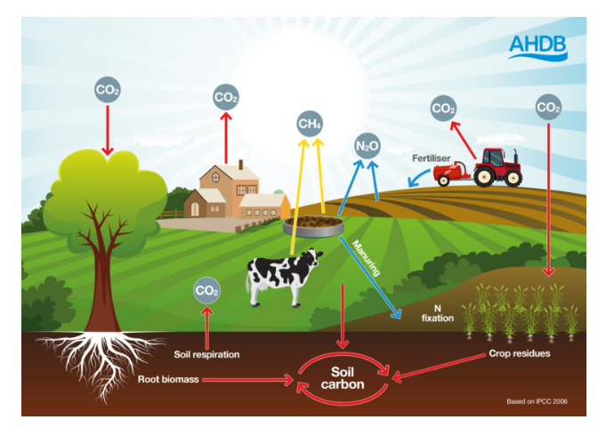
Net zero is the sum of emissions is equal to the sum of sequestration
https://ahdb.org.uk/carbon

Slide 13
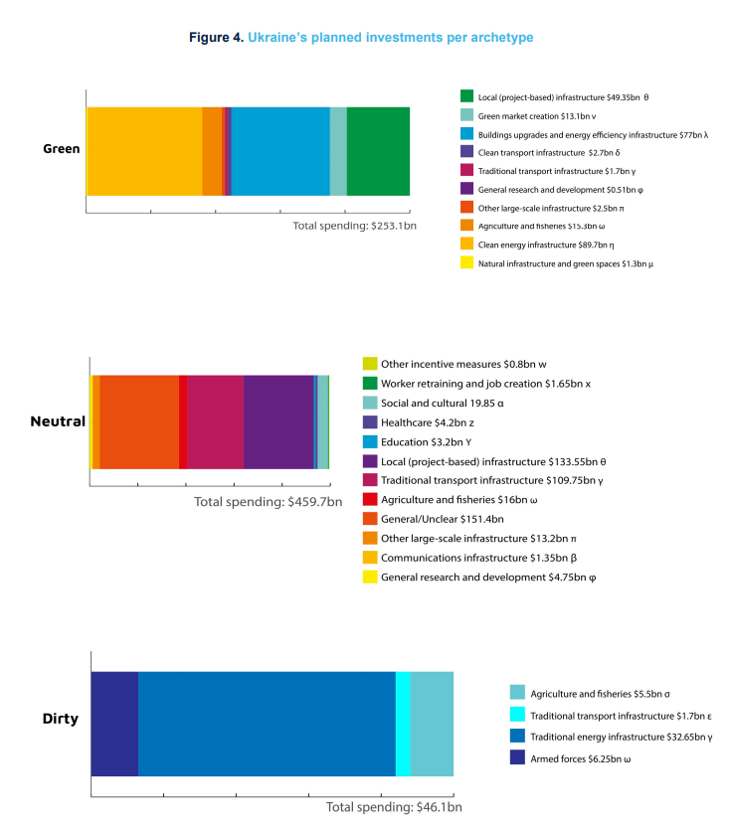
https://www.smithschool.ox.ac.uk/sites/default/files/2023-06/The-Green-Phoenix-Framework-a-climate-positive-plan-for-economic-recovery-in-Ukraine.pdf

Slide 14
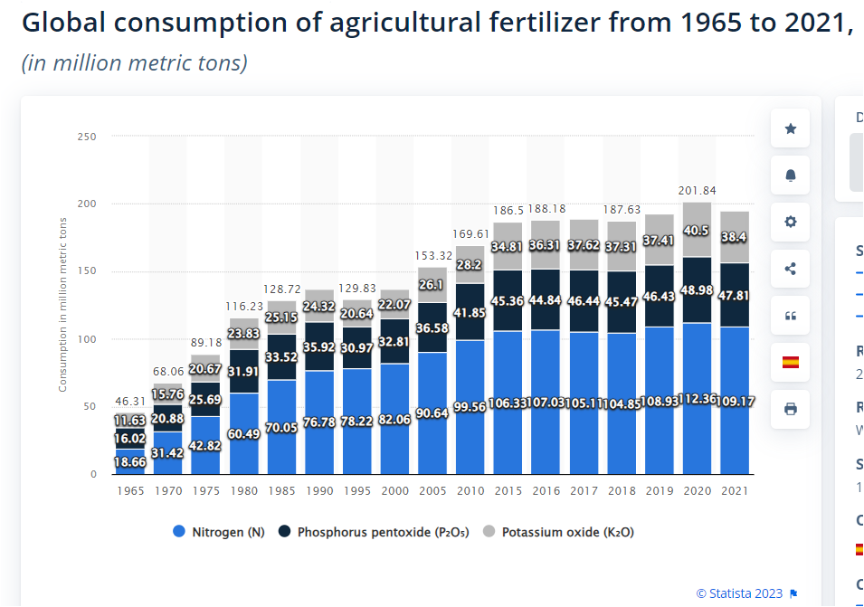
https://www.statista.com/statistics/438967/fertilizer-consumption-globally-by-nutrient/

Slide 15
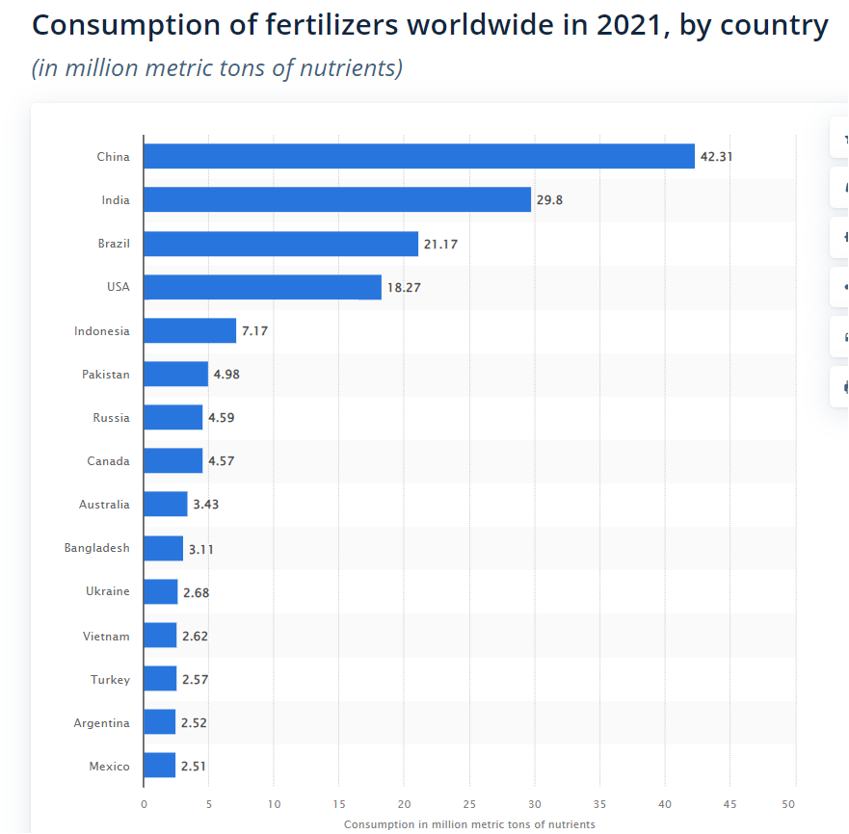

Slide 16
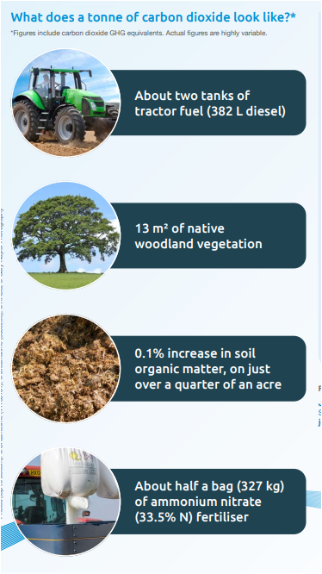
What does a t of CO2 look like?
https://projectblue.blob.core.windows.net/media/Default/Imported%20Publication%20Docs/AHDB%20Cereals%20&%20Oilseeds/Arable%20Focus/2023/Arable%20Focus%20(Winter%202023)%20V2.pdf

Slide 17
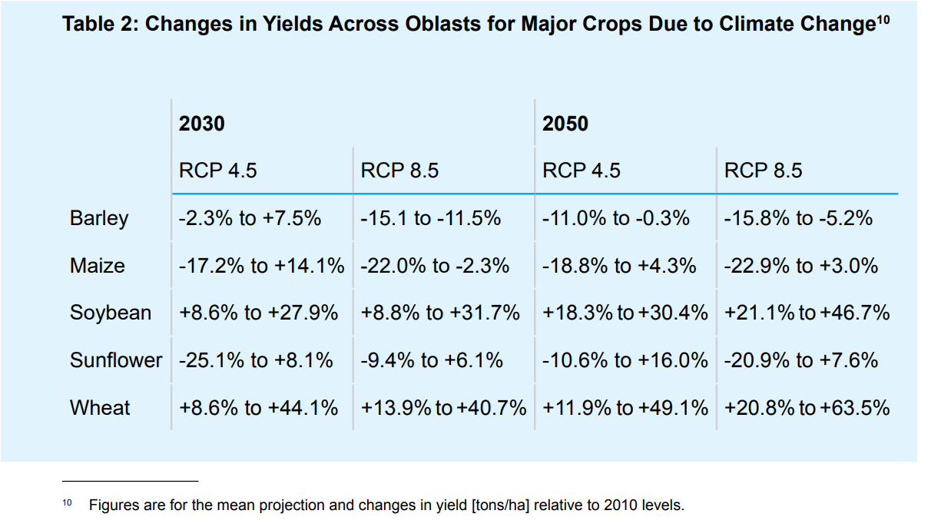

Slide 18
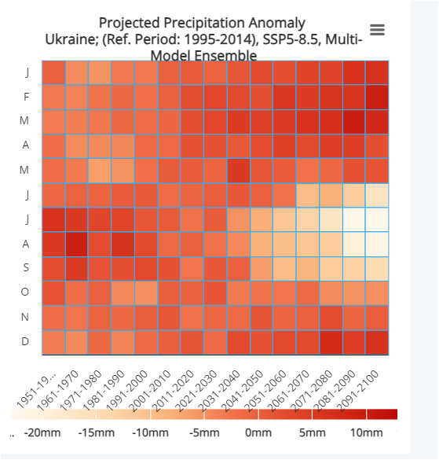
Key messages for Ukraine….
Wetter winters
Drier and hotter summers
Climate Knowledge Portal (2023)

Slide 19
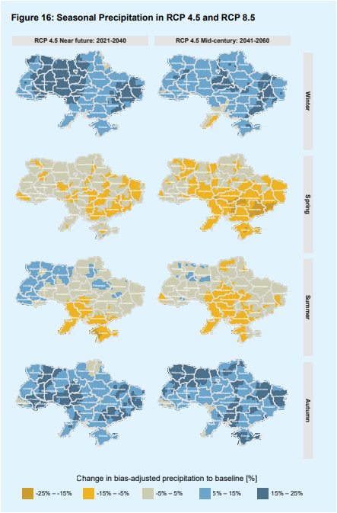
Ukraine. Building Climate Resilience in Agriculture and Forestry
World Bank 2023

Slide 20
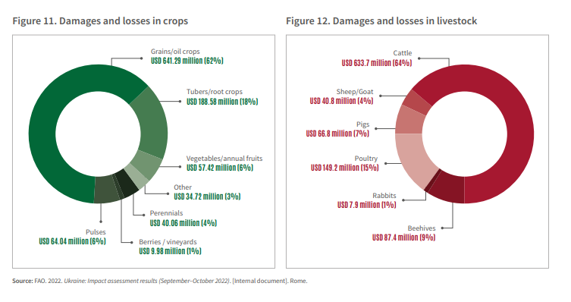
FAO (2022)

Slide 21
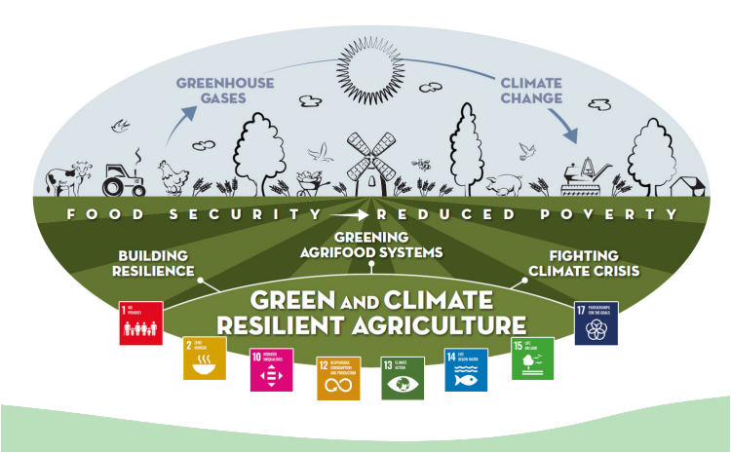
Green and climate resilient agriculture
FAO 2021

Slide 22
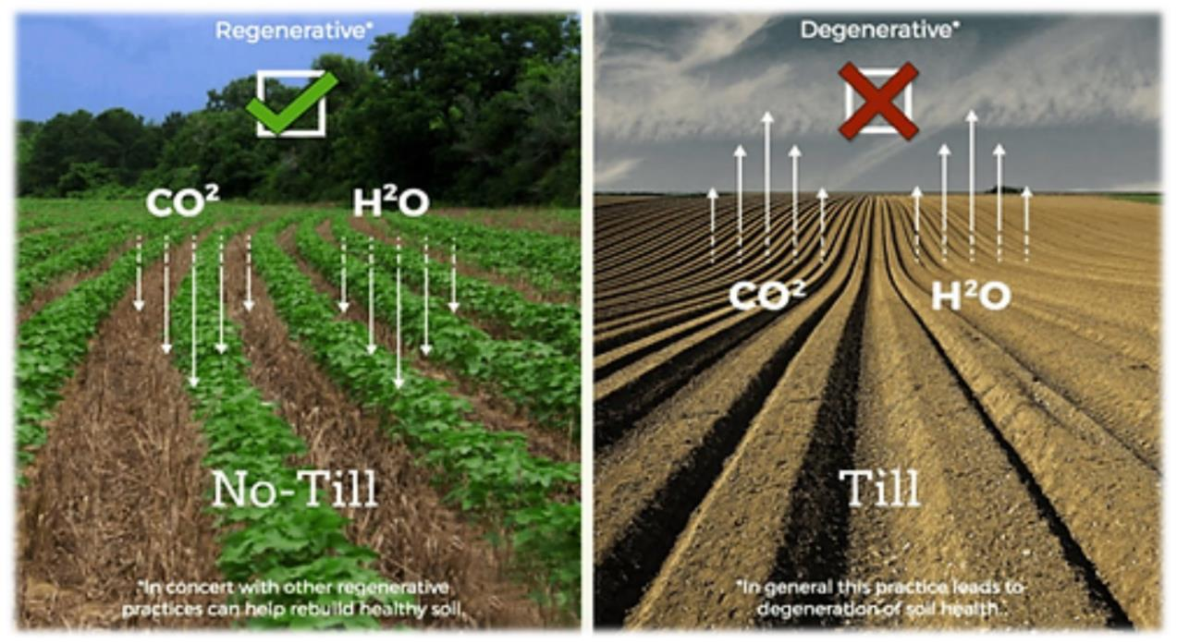

Slide 23
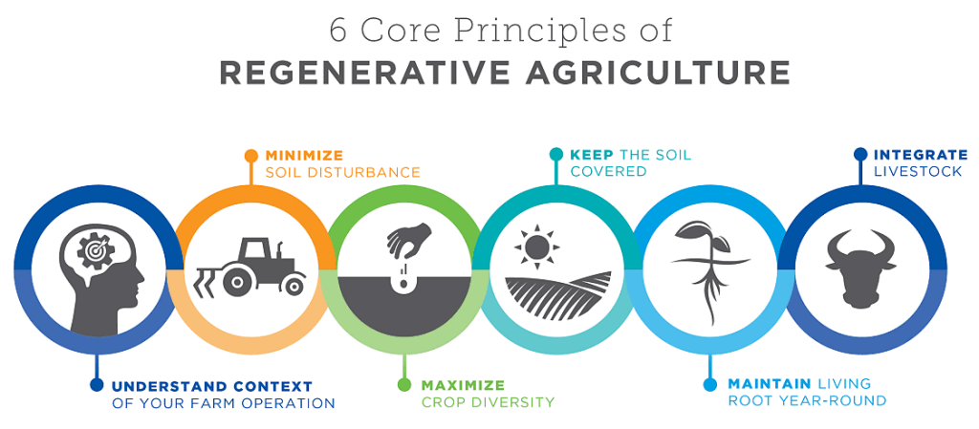
Agricapture CO2 (2023)

Slide 24
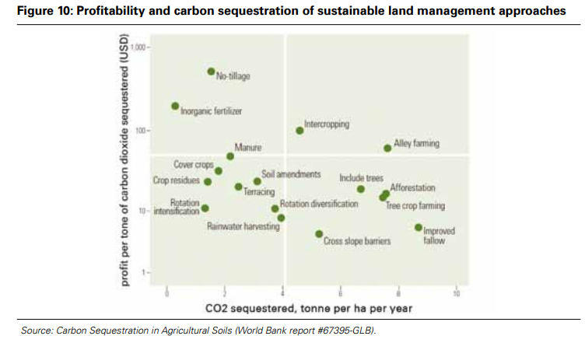
World Bank (2014)

Slide 25
https://documents1.worldbank.org/curated/en/755621468319486733/pdf/918500WP0UKRAI0E0Box385344B00OUO090.pdf
https://documents1.worldbank.org/curated/en/755621468319486733/pdf/918500WP0UKRAI0E0Box385344B00OUO090.pdf

Slide 26
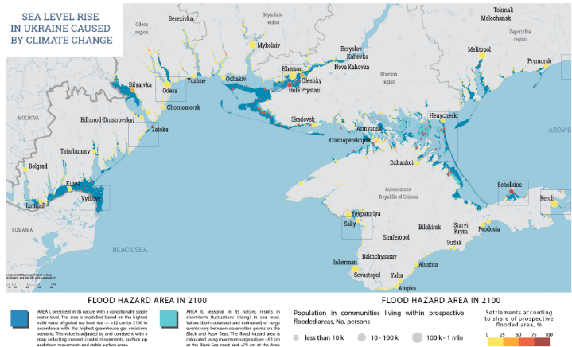
Ukraine's threats from climate change……
Aridisation in southern regions
Floods
Wildfires
Heat waves
Long term sea level rises
https://ceobs.org/ukraine-conflict-environmental-briefing-the-climate-crisis/

Slide 27
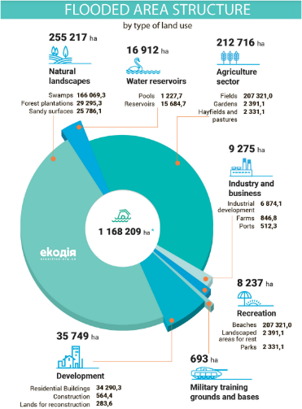
https://en.ecoaction.org.ua/wp-content/uploads/2018/11/water-is-coming-double.pdf

Slide 28
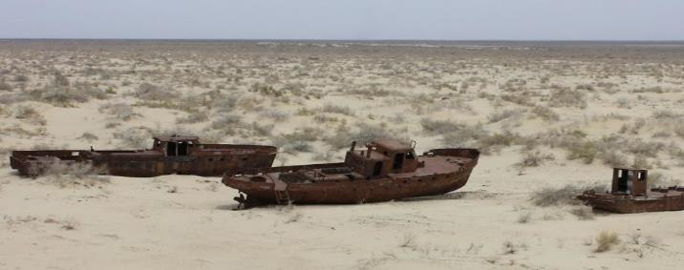
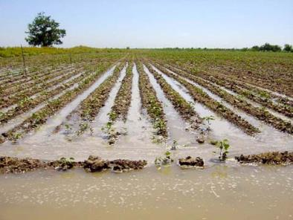
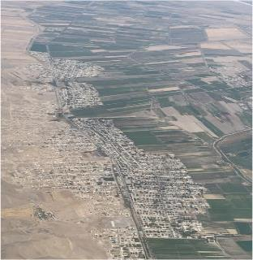
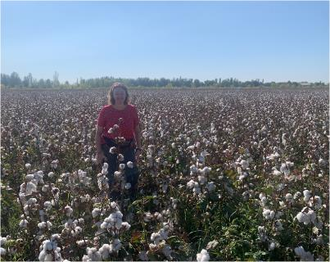
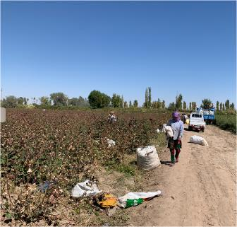
Why did the Aral sea shrink?

Slide 29
How to build agriculture back better
Change farming systems and expectations
Education on regenerative practices
Investment in no till equipment
Natural fertility building
Reducing soil erosion
Become more resilient

Slide 30
References
Agricapture CO2 (2023). https://agricaptureco2.eu/the-six-principles-of-regenerative-farming-why-are-they-important/
AHDB (2023). Various. https://ahdb.org.uk/knowledge-library/arable-focus-the-journal-for-cereals-and-oilseeds
CEOBS (2023). https://ceobs.org/ukraine-conflict-environmental-briefing-the-climate-crisis/
Climate Change Knowledge Portal (20203). https://climateknowledgeportal.worldbank.org/country/ukraine/climate-data-historical
FAO (2021). Green and climate resilient agriculture. https://www.fao.org/3/cb6978en/cb6978en.pdf
FAO (2022). Ukraine: Impact of the war on agriculture and rural livlihoods in Ukraine – Findings of a nationwide rural household survey. https://www.fao.org/3/cc3311en/cc3311en.pdf
World bank (2014). Ukraine: Soil fertility to strengthen climate resilience. https://documents1.worldbank.org/curated/en/755621468319486733/pdf/918500WP0UKRAI0E0Box385344B00OUO090.pdf
World Bank (2023). Ukraine. Building Climate Resilience in Agriculture and Forestry https://documents1.worldbank.org/curated/en/893671643276478711/pdf/Ukraine-Building-Climate-Resilience-in-Agriculture-and-Forestry.pdf
Zagoruichyka et al. (2023). The Green Phoenix Framework: Climate-Positive Plan for Economic Recovery in Ukraine . Oxford Smith School of Enterprise and the Environment | Working Paper No. 23-03 | 21 June 2023 ISSN 2732-4214 (Online)

Slide 31
Any questions?

